Slide 1
HTML basic

Slide 2
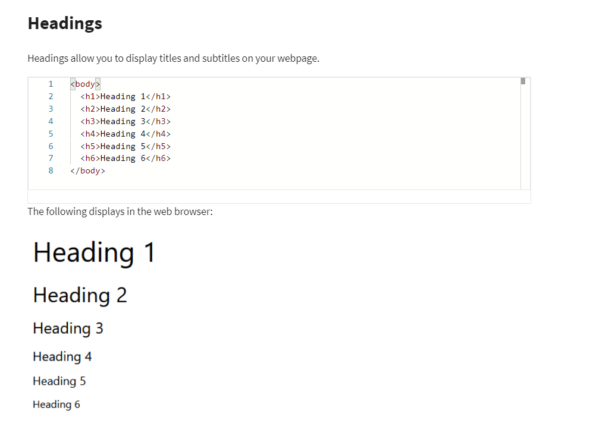
Headings

Slide 3
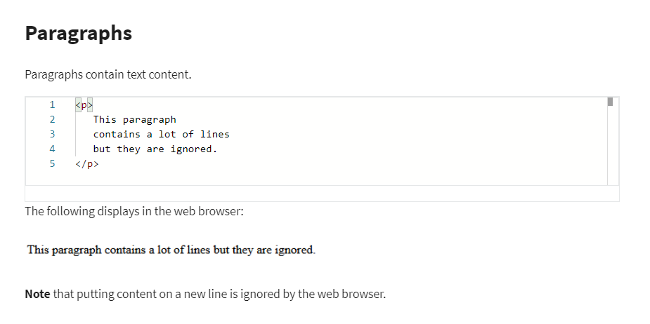
Paragraphs

Slide 4
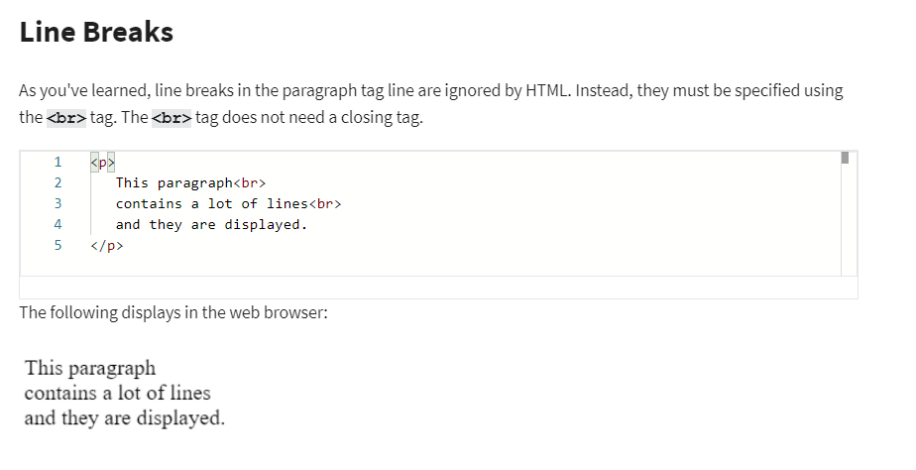
Line breaks

Slide 5
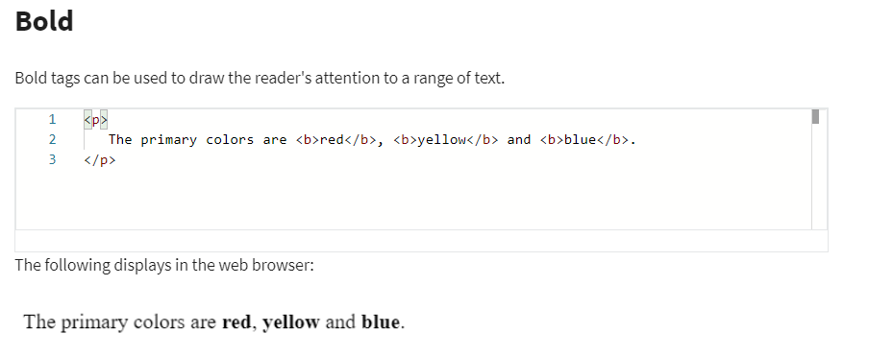
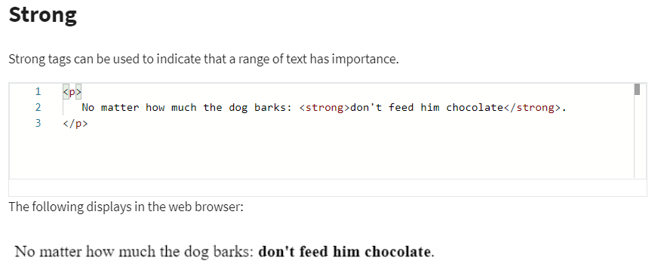
Strong and Bold

Slide 6
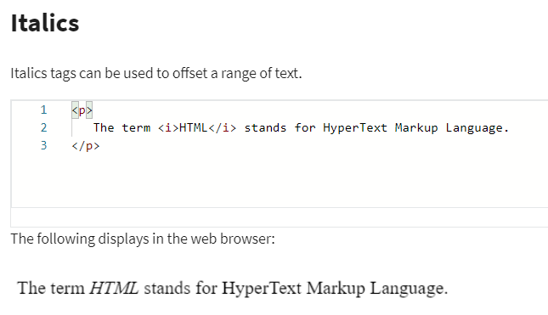
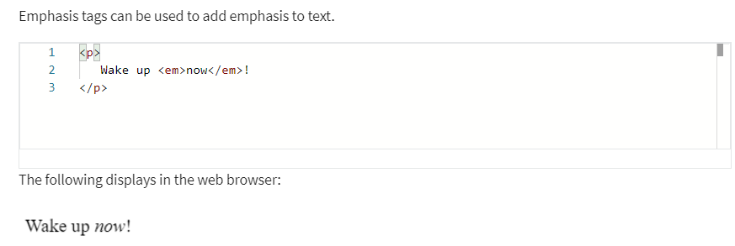
Emphasis and Italics
Emphasis vs. Italics
By default both tags will have the same visual effect in the web browser. The only difference is the meaning.
Emphasis tags stress the text contained in them.
Italics represent off-set text and should be used for technical terms, titles, a thought or a phrase from another language

Slide 7
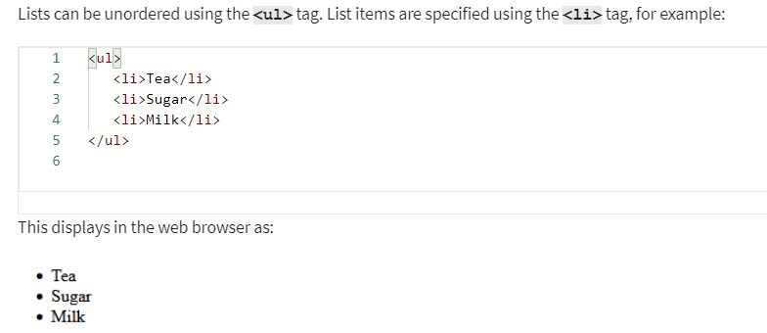
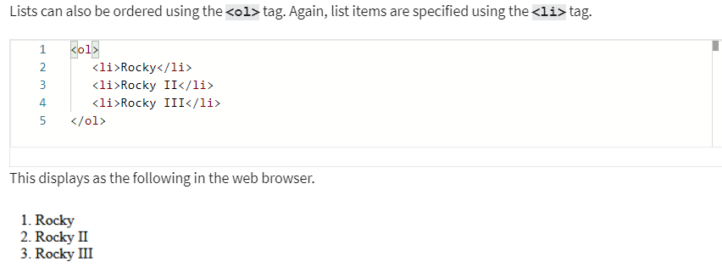
Lists

Slide 8
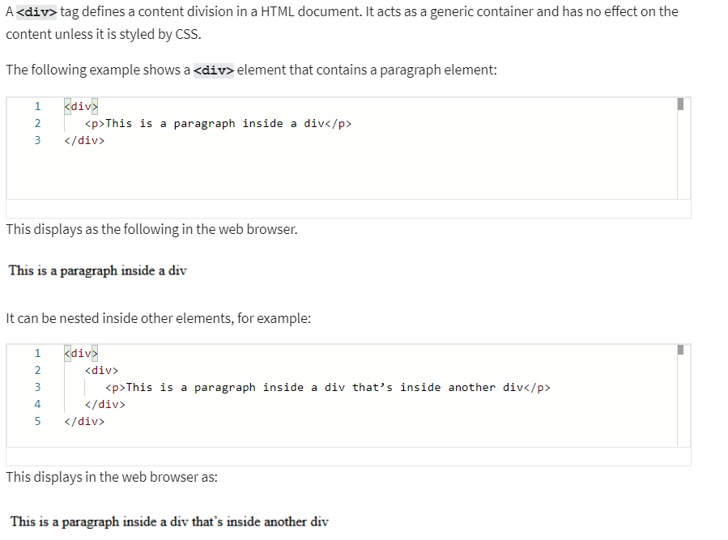
Div tags
the div has no impact on content unless it is styled by CSS.

Slide 9

Comments

Slide 10
Anchor
<a href="location.html">Our location</a>
The page you want to jump to
What you want to show in your main page

Slide 11
Image
<img src="1.jpeg" width = "240" height = "135" alt="a text that will not show in the page">
Width, height, alt are optional

Slide 12
Tables
Table element
Table row element
Table header element
<table>
<tr>
<th>Dish</th>
<th>Price</th>
</tr>
<tr>
<td>Hamburger</td>
<td>$10.00</td>
</tr>
<tr>
<td>Salad</td>
<td>$9.99</td>
</tr>
</table>
Table data element

Slide 13
Forms

Slide 14
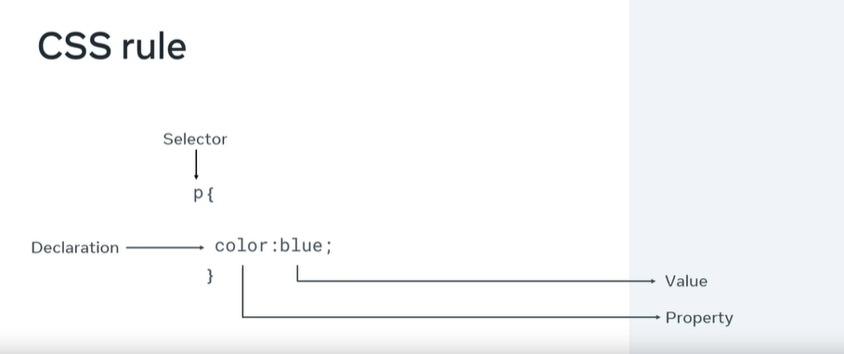
CSS rule
<link rel="stylesheet" href="style.css"/>

Slide 15
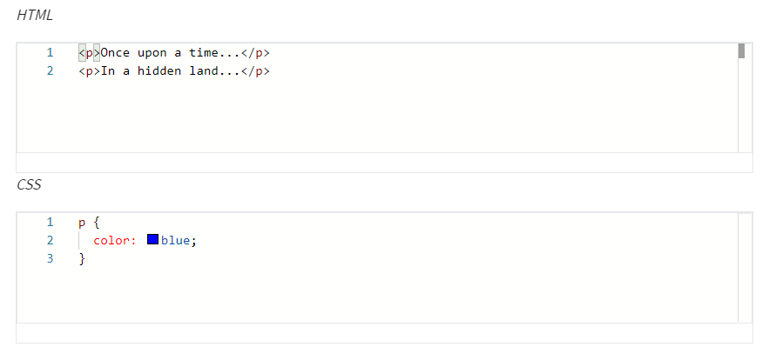
Selectors
Element Selectors

Slide 16
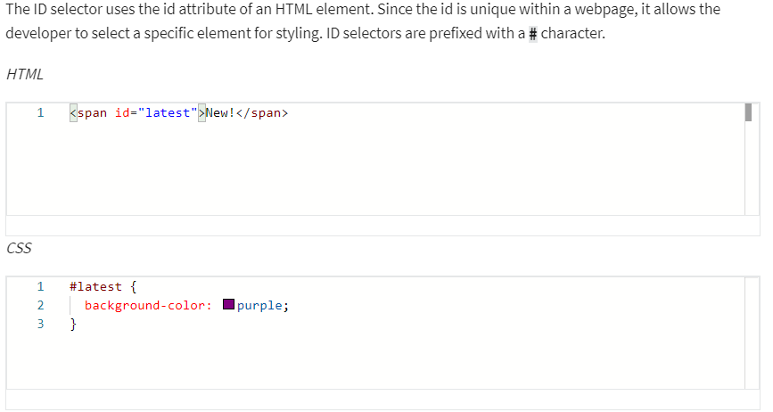
Selectors
ID Selectors

Slide 17
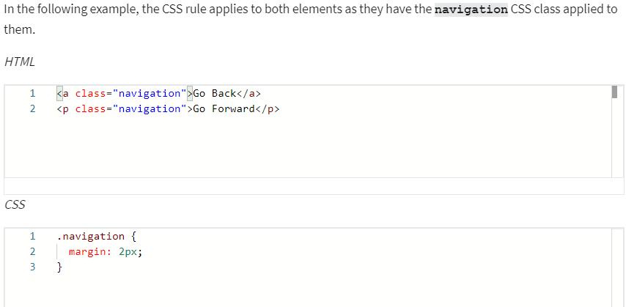
Selectors
Class Selectors

Slide 18
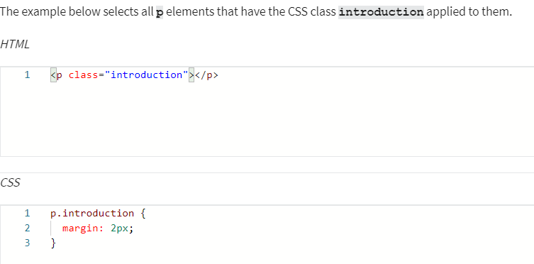
Selectors
Element with Class Selector

Slide 19
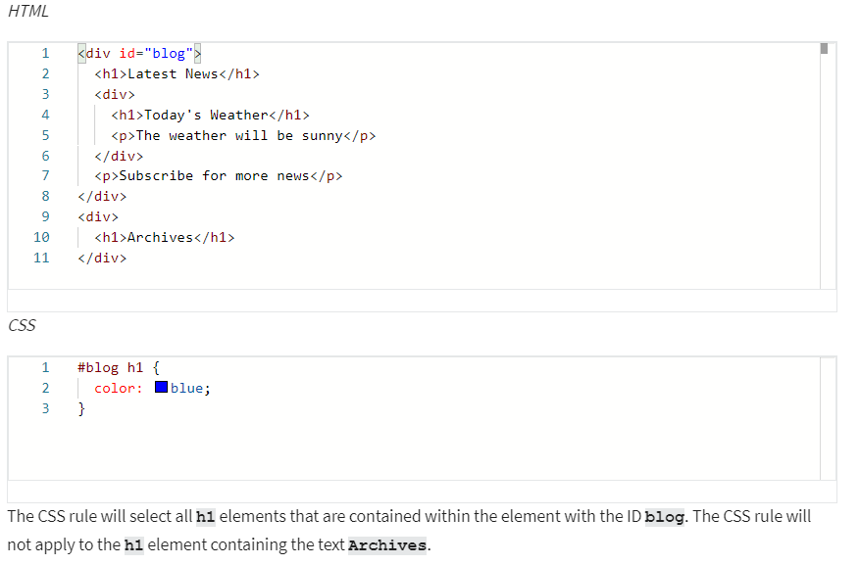
Selectors
Descendant Selectors

Slide 20
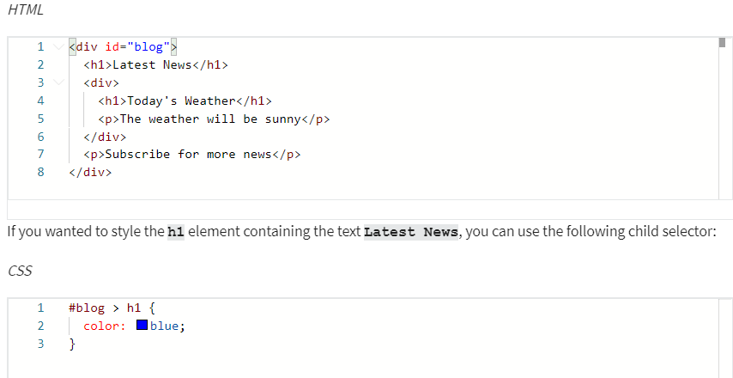
Selectors
Child Selectors
Note that this will not go beyond a single depth level. Therefore, the CSS rule will not be applied to the h1 element containing the text Today's Weather.

Slide 21
Text and color in CSS
color: rgb(255, 0, 0)
color: rgba(255, 0, 0, 0.8);
color: hsl(0, 100%, 50%)
Hex value
Predefined color names
font-family: "Courier New", monospace;
font-size: 12px;
text-transform: uppercase
text-decoration: underline red solid 5px
text-decoration-line: underline;
text-decoration-color: red;
text-decoration-style: solid;
text-decoration-thickness: 5px;
The most commonly used values for the text-transform property are: uppercase, lowercase, capitalize and none.
The most common text-decoration-line values used are: underline, overline, line-through and none.
There are many styles available for the text-decoration-style property; solid, double, dotted, dashed and wavy.

